Slide 1

Introduction to Basic Network security

Slide 2
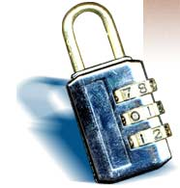
Overview
What is network security?
Why do we need network security?
Who is vulnerable?
Common network security attacks and countermeasures
Firewalls & Intrusion Detection Systems
Denial of Service Attacks
TCP Attacks
Packet Sniffing
Social Problems

Slide 3
What is “Security”
Dictionary.com says:
1. Freedom from risk or danger; safety.
2. Freedom from doubt, anxiety, or fear; confidence.
3. Something that gives or assures safety, as:
1. A group or department of private guards: Call building security if a visitor acts suspicious.
2. Measures adopted by a government to prevent espionage, sabotage, or attack.
3. Measures adopted, as by a business or homeowner, to prevent a crime such as burglary or assault: Security was lax at the firm's smaller plant.
…etc.

Slide 4
What is “Security”
Dictionary.com says:
1. Freedom from risk or danger; safety.
2. Freedom from doubt, anxiety, or fear; confidence.
3. Something that gives or assures safety, as:
1. A group or department of private guards: Call building security if a visitor acts suspicious.
2. Measures adopted by a government to prevent espionage, sabotage, or attack.
3. Measures adopted, as by a business or homeowner, to prevent a crime such as burglary or assault: Security was lax at the firm's smaller plant.
…etc.
Notes:
In other words, having systems in place beforehand which prevent attacks before they begin.

Slide 5
What is “Security”
Dictionary.com says:
1. Freedom from risk or danger; safety.
2. Freedom from doubt, anxiety, or fear; confidence.
3. Something that gives or assures safety, as:
1. A group or department of private guards: Call building security if a visitor acts suspicious.
2. Measures adopted by a government to prevent espionage, sabotage, or attack.
3. Measures adopted, as by a business or homeowner, to prevent a crime such as burglary or assault: Security was lax at the firm's smaller plant.
…etc.
Notes:
Related to the first definition, having peace of mind knowing that your systems are safe and protected.

Slide 6
What is “Security”
Dictionary.com says:
1. Freedom from risk or danger; safety.
2. Freedom from doubt, anxiety, or fear; confidence.
3. Something that gives or assures safety, as:
1. A group or department of private guards: Call building security if a visitor acts suspicious.
2. Measures adopted by a government to prevent espionage, sabotage, or attack.
3. Measures adopted, as by a business or homeowner, to prevent a crime such as burglary or assault: Security was lax at the firm's smaller plant.
…etc.
Notes:
This includes contingency plans for what to do when attackers strike, keeping up with the latest CERT advisories,
hiring network security consultants to find insecurities in your network, etc.

Slide 7
Why do we need network security?
Protect vital information while still allowing access to those who need it
Trade secrets, medical records, etc.
Provide authentication and access control for resources
Ex: AFS
Guarantee availability of resources
Ex: 5 9’s (99.999% reliability)

Slide 8
Who is vulnerable?
Financial institutions and banks
Internet service providers
Pharmaceutical companies
Government and defense agencies
Contractors to various government agencies
Multinational corporations
ANYONE ON THE NETWORK

Slide 9
Common security attacks and their countermeasures
Finding a way into the network
Firewalls
Exploiting software bugs, buffer overflows
Intrusion Detection Systems
Denial of Service
Ingress filtering, IDS
TCP hijacking
IPSec
Packet sniffing
Encryption (SSH, SSL, HTTPS)
Social problems
Education

Slide 10
Common security attacks and their countermeasures

Slide 11

Firewalls
Basic problem – many network applications and protocols have security problems that are fixed over time
Difficult for users to keep up with changes and keep host secure
Solution
Administrators limit access to end hosts by using a firewall
Firewall is kept up-to-date by administrators

Slide 12
Firewalls
A firewall is like a castle with a drawbridge
Only one point of access into the network
This can be good or bad
Can be hardware or software
Ex. Some routers come with firewall functionality
ipfw, ipchains, pf on Unix systems, Windows XP and Mac OS X have built in firewalls
Notes:
Why good? Because it lets you filter what comes in and what goes out.
Why bad? If that point goes down, you are cut off from everyone else. Also, may have lots of congestion at that one point.

Slide 13
Firewalls
Internet
DMZ
Web server, email server, web proxy, etc
Firewall
Firewall
Intranet

Slide 14
Firewalls
Used to filter packets based on a combination of features
These are called packet filtering firewalls
There are other types too, but they will not be discussed
Ex. Drop packets with destination port of 23 (Telnet)
Can use any combination of IP/UDP/TCP header information
man ipfw on unix47 for much more detail
But why don’t we just turn Telnet off?

Slide 15
Firewalls
Here is what a computer with a default Windows XP install looks like:
135/tcp open loc-srv
139/tcp open netbios-ssn
445/tcp open microsoft-ds
1025/tcp open NFS-or-IIS
3389/tcp open ms-term-serv
5000/tcp open UPnP
Might need some of these services, or might not be able to control all the machines on the network

Slide 16
Firewalls
What does a firewall rule look like?
Depends on the firewall used
Example: ipfw
/sbin/ipfw add deny tcp from cracker.evil.org to wolf.tambov.su telnet
Other examples: WinXP & Mac OS X have built in and third party firewalls
Different graphical user interfaces
Varying amounts of complexity and power

Slide 17

Intrusion Detection
Used to monitor for “suspicious activity” on a network
Can protect against known software exploits, like buffer overflows
Open Source IDS: Snort, www.snort.org

Slide 18
Intrusion Detection
Uses “intrusion signatures”
Well known patterns of behavior
Ping sweeps, port scanning, web server indexing, OS fingerprinting, DoS attempts, etc.
Example
IRIX vulnerability in webdist.cgi
Can make a rule to drop packets containing the line
“/cgi-bin/webdist.cgi?distloc=?;cat%20/etc/passwd”
However, IDS is only useful if contingency plans are in place to curb attacks as they are occurring

Slide 19

Minor Detour…
Say we got the /etc/passwd file from the IRIX server
What can we do with it?

Slide 20

Dictionary Attack
We can run a dictionary attack on the passwords
The passwords in /etc/passwd are encrypted with the crypt(3) function (one-way hash)
Can take a dictionary of words, crypt() them all, and compare with the hashed passwords
This is why your passwords should be meaningless random junk!
For example, “sdfo839f” is a good password
That is not my andrew password
Please don’t try it either

Slide 21

Denial of Service
Purpose: Make a network service unusable, usually by overloading the server or network
Many different kinds of DoS attacks
SYN flooding
SMURF
Distributed attacks
Mini Case Study: Code-Red

Slide 22
Denial of Service
SYN flooding attack
Send SYN packets with bogus source address
Why?
Server responds with SYN ACK and keeps state about TCP half-open connection
Eventually, server memory is exhausted with this state
Solution: use “SYN cookies”
In response to a SYN, create a special “cookie” for the connection, and forget everything else
Then, can recreate the forgotten information when the ACK comes in from a legitimate connection
Notes:
Forge source IP so that the victim can’t figure out who you are.

Slide 23
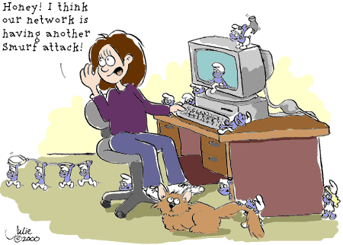
Denial of Service

Slide 24
Denial of Service
SMURF
Source IP address of a broadcast ping is forged
Large number of machines respond back to victim, overloading it

Slide 25
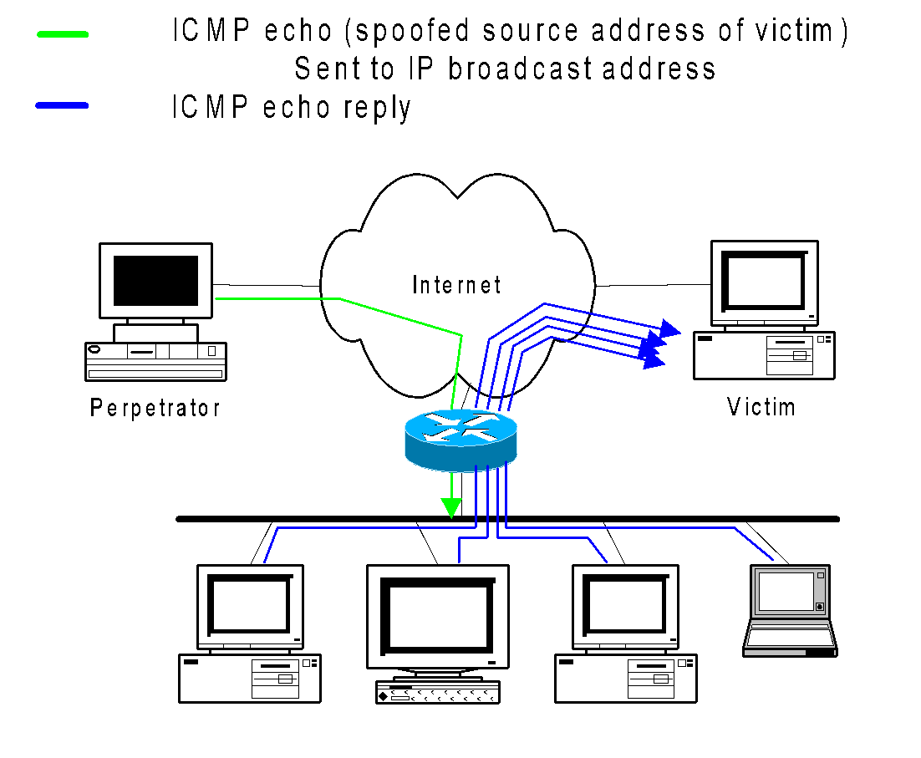
Denial of Service

Slide 26
Denial of Service
Distributed Denial of Service
Same techniques as regular DoS, but on a much larger scale
Example: Sub7Server Trojan and IRC bots
Infect a large number of machines with a “zombie” program
Zombie program logs into an IRC channel and awaits commands
Example:
Bot command: !p4 207.71.92.193
Result: runs ping.exe 207.71.92.193 -l 65500 -n 10000
Sends 10,000 64k packets to the host (655MB!)
Read more at: http://grc.com/dos/grcdos.htm

Slide 27
Denial of Service
Mini Case Study – CodeRed
July 19, 2001: over 359,000 computers infected with Code-Red in less than 14 hours
Used a recently known buffer exploit in Microsoft IIS
Damages estimated in excess of $2.6 billion

Slide 28
Denial of Service
Why is this under the Denial of Service category?
CodeRed launched a DDOS attack against www1.whitehouse.gov from the 20th to the 28th of every month!
Spent the rest of its time infecting other hosts

Slide 29
Denial of Service
How can we protect ourselves?
Ingress filtering
If the source IP of a packet comes in on an interface which does not have a route to that packet, then drop it
RFC 2267 has more information about this
Stay on top of CERT advisories and the latest security patches
A fix for the IIS buffer overflow was released sixteen days before CodeRed had been deployed!

Slide 30
Thank You

